Slide 1
How to Get ATO for your (PCF) Platform
Linh Nguyen
16 December 2019

Slide 2

Objective
A systematic overview of a security “accreditation” process of PCF in order to obtain an “Authority-to-Operate” approval
A systemic approach to leading the customer through the process
Disclaimer here
CLEAR THE NOTES BEFORE EXTERNAL SHARING!
Notes:
Reuse with other agencies

Slide 3
Agenda, Topics, Whatever you need to know...
What
When
Who
Actors & Roles
How
Process
Artifacts
Resources
Intangibles
Beyond ATO
Notes:
Reuse with other agencies
App Security automation (CI/CD): Nav at lunch
SMC Process
Demo a platform security example: e.g. outdated buildpack
What’s the role of the PA

Slide 4
Perhaps Not Covered Today, But…
What is and why Security A&A?
STIG’s
Configuration of PCF security services (e.g. SSO)
Security automation
Application Security Automation

Slide 5
FAQ’s, Terms & Definitions
Definitions:
Accreditation vs. A&A
Authority-to-Operate (ATO)
Continuous ATO
Reciprocity
ICD 503 vs. DoD RMF
NIST
Control Correlation Identifiers (CCI’s)
SSP / BOE
POA&M
Others?
Notes:
DoD used to use DoD Information Assurance Certification and Accreditation Process (DIACAP).
CCI https://public.cyber.mil/stigs/cci/

Slide 6
Information System Security [fill-in-the-blank]
Engineer (ISSE)
INFOSEC engineer(s)
Role:
Produce & coordinate SSP / BOE artifacts
Delivers:
SSP / BOE
eMass record(s)
Manager (ISSM)
A customer GPOC
Role:
Determines & request approval of C.I.A. profile
Specifies security process and required SSP artifacts
External liaison
Delivers:
System Cat Memo
List of SSP artifacts
Formal submission of BOE, eMass record(s)
Guidance to Platform Operations
POA&M
Customer Platform Operations
Defined Goal to get to Production
Acknowledgement that Production is a Journey - not binary
Identification of all parties involved in Production
Continuous Integration and Continuous Delivery pipelines
ATO Security Approval
Tools & automation used for application operations

Slide 7
Independent Tester; Security Authorities
Cyber Assessor
INFOSEC engineer(s)
Role:
Third-party, Independent evaluation of IaaS and PaaS
Manual & Automated security tests (e.g. STIG)
Reviews SSP / BOE
Assess security risk postures
Delivers:
Cyber Risk Assessment Report
Security Control Assessor Representative (SCAR)
GPOC from Authorizing Official organization
Role:
Adjudicates Cyber Risk Assessment Report
Reviews security controls implementation
Delivers:
Recommendation to DAO
Designated Authorizing Official (DAO)
Authorizing Official
Role:
Security risk owner
Decision-maker
Delivers:
Grants ATO

Slide 8
Start delivering a new platform capability with Pivotal at my location and/or a Pivotal office
Ingrain reliability practices in my team, with Pivotal’s help
Scale delivery of the platform
with my team at my location
Platform Journey
Launch The Platform Capability
Build a balanced product team, get an app to production
Extend The Platform
Launch more capabilities, cement culture + practices
Use The Platform At Scale
Culture established, Pivotal ramps down
Pivotal Platform Dojo
PKS Small Deploy
Platform Health Check
Pivotal Platform Dojo
Platform Health Check
Pivotal Platform Dojo
Designated Support Engineer / Customer Reliability Engineers
Security Approval
Process
Educate & Create SSP
Cyber Assessment
Decision Point
Platform Owner Organization
Create SSP / BOE Artifacts
Support Testers; Inform DAO; Conf Mgt
Day 2 Platform Security Operations
Address POA&M’s
Inform Platform Operations
Update BOE; Submit eMass Record
Create App Control Inheritance
Independent Testing
OnBoard Applications!
Learn about Platform and PCF Security
Conduct Cyber Assessment
Go Live!
Authorization
Learn about Platform and PCF Security
Inform and Advise
Adjudicate & Grant ATO!
App Authorization Approach
Notes:
Multiple, concurrent work streams done by different groups. You (e.g., PA) will need to collaborate with each group to lead each work stream.

Slide 9
System Security Plan / Body of Evidence artifacts
Platform CONOPS
Security Controls Traceability Matrix (SCTM)
Ports, Protocols & Services list
Justifications (If Required)
Systems Architecture diagrams
Network
Layer 2 (PCF Internal)
Layer 3 (PCF Ingress / Egress)
PCF Components
PCF within the CI/CD flow
App End-User relation to PCF
+/-
Notes:
https://drive.google.com/drive/folders/1RNfy_IgcCd1ZSTB9h5do6A4HI0CktJa-

Slide 10
Resources: Internal & External
People
Pivotal Compliance Innovation
During cyber assessment / scans
Fed PA’s
Lead the customer throughout the ATO process
Other Customer ISSE/ISSM’s
Third-party, independent
Tools, Guides
Auditor’s Guide to PCF
Compliance Scanner for PCF
CS Results Explanation
PCI Roadmap
STIG Viewer
Trailblazers
Templates and Examples
Other ATO packages (e.g. eMass record)
Notes:
E.g. Lt. Brian Altizer’s Kessel Run Risk Management Playbook
https://drive.google.com/open?id=0B8LcIK01NmcRX00xOHNmTnlxTlF6anBBVjljRENhWjJFZ3R3

Slide 11
Pivotal Compliance Scanner
Educate the Cyber Assessor on what is the tool
Install the tile on the “To-Be” PCF foundation(s)
Select these benchmarks: STIG (aka “full STIG”) + Reduced STIG
View the results in the DISA STIG Viewer
Explain of findings in “Latest STIG (for Customers)”
Not included in scan results
Available upon request to the PCI team
Request support from PCI (Tamelia, Nitin… Invaluable!)
Comparison of Manual vs. Automated STIG check
Inspect or Demonstrate Cat I and II findings (as requested)
SSH into a BOSH-deployed PCF component vm
If not on the actual foundation, then a sample foundation using the same stemcell is suitable

Slide 12
Good PA Practices: Intangibles
Educate!
Begin with why; Where PCF fits in
Platform 101
How Platform implements security “GAAP”
Cloud-native security measures
Demonstrate
Collaborate often with ISSE/ISSM
Inform Platform Operations
Advise & inform SCAR and DAO
Inform App Dev teams
Leverage the Platform Owner / Champion / Customer as your hammer
Leverage prior ATO’s
Like it or not...you’re the systems integrator

Slide 13
Beyond ATO
Platform Operations
Day 2 security processes
ISV Services
Separate approval process
Working with app product teams
DevOps 1:M
Apps Onboarding
Influence & shape Customer Leadership strategy
Internal & External
Accelerated approval of apps
More Backlog to further enable to customer’s Platform Journey

Slide 14
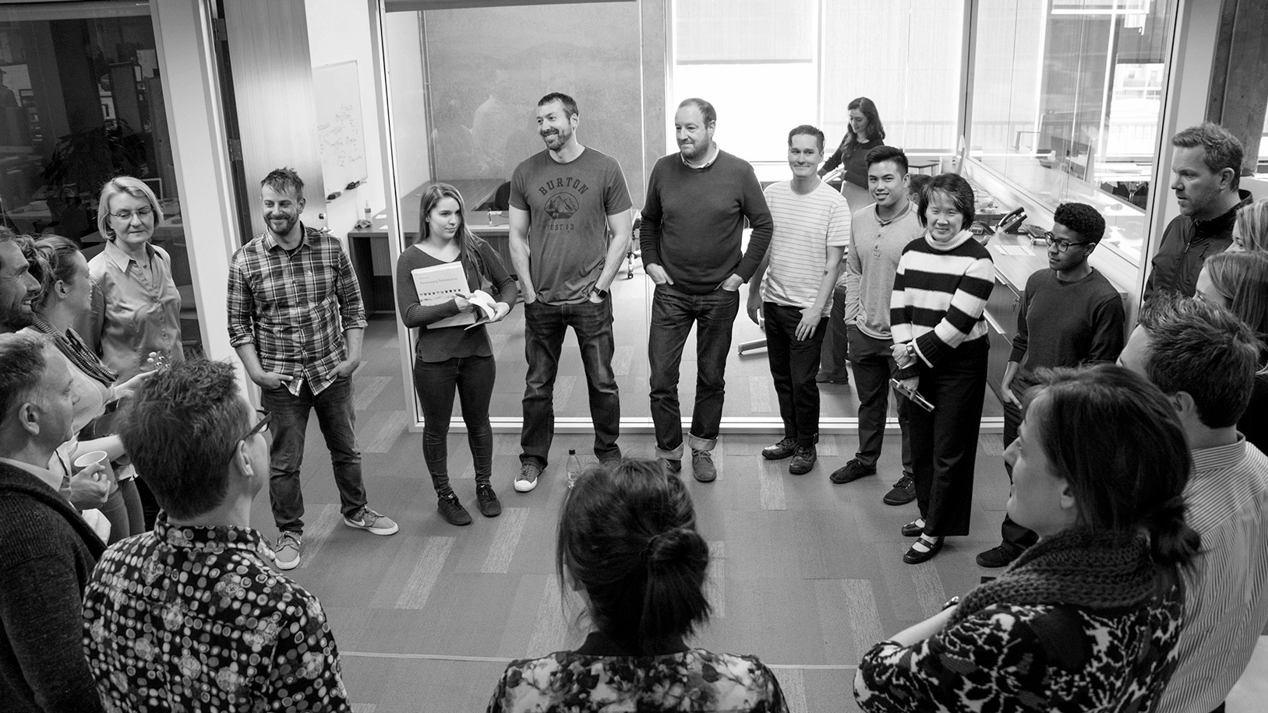
FEDERAL PLATFORM ARCHITECTURE
Transforming How USG Authorizes Platforms and Apps
© Copyright 2017 Pivotal Software, Inc. All rights Reserved.

